Slide 1
Module-2

Slide 2


Module 2 | Data Structures: Trees,Graphs | No. of Hours: 12hrs
Recover the BST Views of a Tree Vertical Order Traversal Boundary Traversal BFS,DFS Dial’s Algorithm
Bellman-Ford Algorithm
Topological Sort
Heap Sort
Binomial Heap
K ary heap
Winner Tree

Slide 3
Trees
A tree is a non-linear data structure that consists of nodes connected by edges. It is a hierarchical structure where each node has a parent-child relationship. The topmost node is called the root, and the nodes that have no children are called leaves.

Slide 4
Points to remember on trees
Height of a Tree: The height of a tree is the length path from the root to a leaf node.
Height(h)➔-1(If tree is empty)
0(if tree has only one node)
1+max(height(left_subtree),height(right_subtree))
Depth of a Tree: The Depth of a node in a tree is the no.of edges from the root to that node.
It can also be seen as the level of the node within a tree.

Slide 5
Size of a tree: Total no.of nodes
size(T)→0(if tree is empty)
1+size(left_subtree)+size(right_subtree)
Degree of a Node: It is the no. of children it has.

Slide 6
Binary Tree Creation
Sample input1:8 3 10 1 6 -1 14 -1 -1 4 7 13 -1 -1 -1 -1 -1 -1 -1
Sample input 2:1 2 3 4 5 6 7 -1 -1 -1 -1 -1 -1 -1 -1
Sample input 3: 5 6 10 2 3 -1 -1 -1 -1 -1 9 -1 -1
Sample input 4: 2 4 5 6 -1 -1 7 20 30 80 90 -1 -1 8 -1 -1 9 -1 -1 -1 -1 -1 -1

Slide 7
Binary Tree Creation
public class BT {
static class Node{
int data;
Node left,right;
Node(int v)
{
data=v;
left=right=null;
}
}

Slide 8
static Node root;
static Scanner sc=new Scanner(System.in);
public static void create(int v)
{
Queue<Node> q=new LinkedList<>();
root=new Node(v);
q.add(root);
while(!q.isEmpty())
{
Node temp=q.poll();
int val=sc.nextInt();
if(val!=-1) {
temp.left=new Node(val);
q.add(temp.left);
}
val=sc.nextInt();
if(val!=-1)
{
temp.right=new Node(val);
q.add(temp.right);
}
}
}

Slide 9
34)public static void inorder(Node root)
{
if(root==null)
return;
inorder(root.left);
System.out.println(root.data+" ");
inorder(root.right);
}
public static void main(String[] args) {
int ele=sc.nextInt();
create(ele);
inorder(root);
}
}

Slide 10
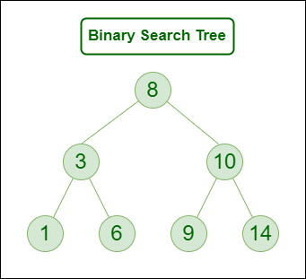
BST(Binary Search Tree)
A Binary Search Tree (BST) is a binary tree in which each node follows a specific ordering property:
Left Subtree: Contains nodes with values less than the parent node.
Right Subtree: Contains nodes with values greater than the parent node.

Slide 11
Number of nodes in each level: 2^{k}
Maximum Number of nodes in a BST of height h: 2 ^{h+1} -1
Minimum Number of nodes in a BST of height h: h+1

Slide 12
Examples
Input-1 45, 15, 79, 90, 10, 55, 12, 20, 50
Input-2 28, 33, 38, 31, 43, 58, 48

Slide 13
BST Creation
class Node{
int data;
Node right;
Node left;
Node(int v){
data=v;
right=null;
left=null;
}}

Slide 14
public class BST {
static Node root;
static Node insert(Node root,int ele){
Node newnode =new Node(ele);
if(root==null)
root=newnode;
else if(root.data>=ele)
root.left=insert(root.left,ele);
else
root.right=insert(root.right,ele);
return root;
}

Slide 15
//inorder traversal
static void inorder(Node root) {
if (root != null) {
inorder(root.left);
System.out.print(root.data + " ");
inorder(root.right);
}
}
//preorder traversal
static void preorder(Node root) {
if (root != null) {
System.out.print(root.data + " ");
preorder(root.left);
preorder(root.right);
}
}

Slide 16
//postorder traversal
static void postorder(Node root) {
if (root != null) {
postorder(root.left);
postorder(root.right);
System.out.print(root.data + " ");
}
}

Slide 17
public static void main(String[] args) {
Scanner sc=new Scanner(System.in);
int n=sc.nextInt();
for(int i=0;i<n;i++)
root=insert(root,sc.nextInt());
System.out.println("Inorder Traversal");
inorder(root);
System.out.println();
System.out.println("preorder traversal");
preorder(root);
System.out.println();
System.out.println("post order traversal");
postorder(root);
}}

Slide 18
Problem Statement
You are given a binary search tree (BST) where two nodes have been swapped by mistake. The task is to identify the swapped nodes and restore the tree to its correct state.
A Binary Search Tree (BST) is a tree in which for each node:
The left subtree contains nodes with values smaller than the node's value.
The right subtree contains nodes with values greater than the node's value.
In this problem, two nodes in the tree have been swapped, and this violates the BST properties. Your goal is to recover the tree by swapping the two incorrect nodes back to their correct positions.

Slide 19
Sample Input 0
3 1 4 N N 2
Sample Output 0
2 1 4 3
Sample Input 1
7 4 N 1 8 N 2
Sample Output 1
8 4 1 7 2

Slide 20
Code
import java.util.*;class node {
int data; node left, right;
node(int d) {
data = d;
left = right = null; }}
class BT {
node root = null; node first = null; node last = null; node middle = null; node prev = null; Scanner sc = new Scanner(System.in);
node insert() { int d = sc.nextInt();
if (d == -1) { return null; }
node tnode = new node(d);
Queue<node> q = new LinkedList<>();
q.add(tnode);
root = tnode;

Slide 21
while (!q.isEmpty()) {
node curr = q.poll();
int l = sc.nextInt();
if (l != -1) {
node lnode = new node(l);
curr.left = lnode;
q.add(lnode); }
int r = sc.nextInt();
if (r != -1) {
node rnode = new node(r);
curr.right = rnode;
q.add(rnode); } }
return root; }

Slide 22
private void inorder(node root) {
if (root == null) {
return; }
inorder(root.left);
if (prev != null && root.data < prev.data) {
if (first == null) {
first = prev;
middle = root;
} else {
last = root;
} }
prev = root;
inorder(root.right); }

Slide 23
void recoverTree(node root) {
prev = new node(Integer.MIN_VALUE);
inorder(root);
if (first != null && last != null) {
int temp = first.data;
first.data = last.data;
last.data = temp; }
else if (first != null && middle != null) {
int temp = first.data;
first.data = middle.data;
middle.data = temp; } }

Slide 24
class Main {
public static void main(String ar[]) {
BT b = new BT();
b.root = b.insert();
b.Inorder(b.root);
b.recoverTree(b.root);
System.out.println();
b.levelorder(b.root);//declare a method levelorder(root)
}}

Slide 25
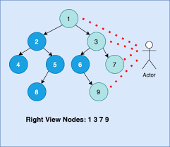
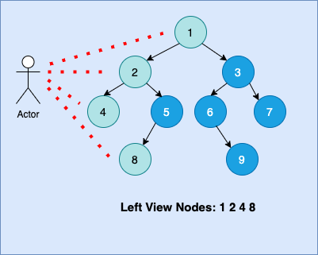
Views of a tree

Slide 26
code
public class ViewsOfTree {
static class node{
int data;
node left;
node right;
node(int d){
data=d;
left=right=null;
}
}
static node root;

Slide 27
public static void create()
{
Scanner sc=new Scanner(System.in);
int n=sc.nextInt();
if(n==-1)
return;
node newnode=new node(n);
root=newnode;
Queue<node> q=new LinkedList<>();
q.add(root);
while(!q.isEmpty())
{
node curr=q.poll();
int l=sc.nextInt();
if(l!=-1)
{
node nn=new node(l);
curr.left=nn;
q.add(nn);
}
int r=sc.nextInt();
if(r!=-1)
{
node nn=new node(r);
curr.right=nn;
q.add(nn);
}
}
}

Slide 28
public static void leftview(node root,List<Integer> l,int size )
{
if(root==null)return;
if(size==l.size())
l.add(root.data);
if(root.left!=null)
leftview(root.left,l,size+1);
if(root.right!=null)
leftview(root.right,l,size+1);
}

Slide 29
public static void rightview(node root,List<Integer> l,int size )
{
if(root==null)return;
if(size==l.size())
l.add(root.data);
if(root.right!=null)
rightview(root.right,l,size+1);
if(root.left!=null)
rightview(root.left,l,size+1);
}

Slide 30
68)public static void main(String[] args) {
create();
List<Integer> l=new ArrayList<>();
leftview(root,l,0);
System.out.println(l);
List<Integer> r=new ArrayList<>();
rightview(root,r,0);
System.out.println(r);
}
}

Slide 31
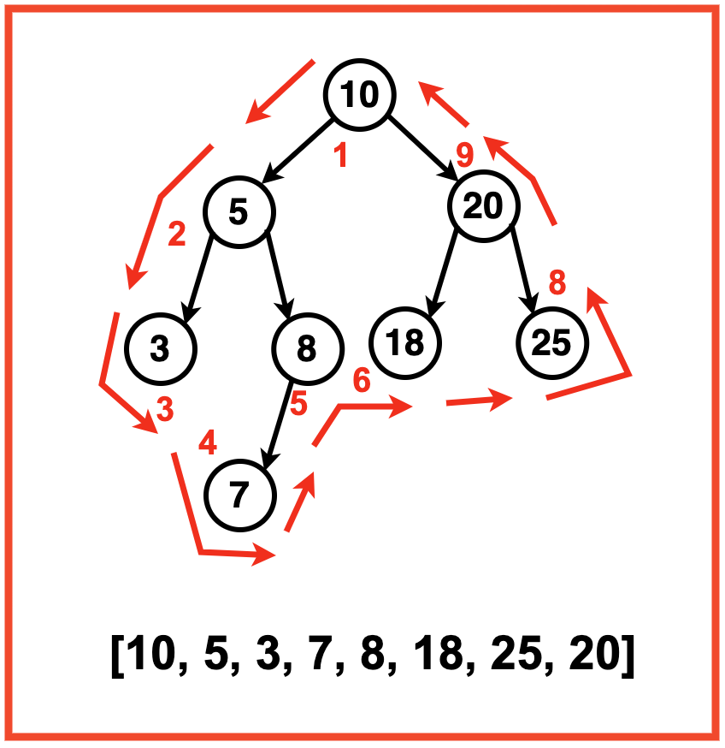
Boundary Traversal

Slide 32
Code
import java.util.ArrayList;
import java.util.LinkedList;
import java.util.Queue;
import java.util.Scanner;
public class Boundary_Traversal {
static class Node {
int data;
Node left;
Node right;
Node(int n) {
data = n;
left = right = null;
}
}

Slide 33
static Node root;
static void create() {
Queue<Node> q = new LinkedList<>();
Scanner sc = new Scanner(System.in);
int n = sc.nextInt();
if (n == -1)
return;
root = new Node(n);
q.add(root);
while (!q.isEmpty()) {
Node curr = q.poll();
int l = sc.nextInt();
if (l != -1) {
Node leftNode = new Node(l);
curr.left = leftNode;
q.add(leftNode);
}
int r = sc.nextInt();
if (r != -1) {
Node rightNode = new Node(r);
curr.right = rightNode;
q.add(rightNode);
}
}
}

Slide 34
static ArrayList<Integer> boundaryTraversal(Node root) {
ArrayList<Integer> res = new ArrayList<>();
if (root == null)
return res;
res.add(root.data);
addLeftBoundary(root, res);
addLeaves(root, res);
addRightBoundary(root, res);
return res;
}

Slide 35
static void addLeftBoundary(Node node, ArrayList<Integer> res) {
Node curr = node.left;
while (curr != null) {
if (!isLeaf(curr)) {
res.add(curr.data);
}
if (curr.left != null) {
curr = curr.left;
} else {
curr = curr.right;
}
}
}

Slide 36
static void addRightBoundary(Node node, ArrayList<Integer> res) {
Node curr = node.right;
ArrayList<Integer> temp = new ArrayList<>();
while (curr != null) {
if (!isLeaf(curr))
temp.add(curr.data);
if (curr.right != null)
curr = curr.right;
else
curr = curr.left;
}
for (int i = temp.size() - 1; i >= 0; i--) {
res.add(temp.get(i));
}
}

Slide 37
static void addLeaves(Node node, ArrayList<Integer> res) {
if (isLeaf(node)) {
res.add(node.data);
return;
}
if (node.left != null) {
addLeaves(node.left, res);
}
if (node.right != null) {
addLeaves(node.right, res);
}
}

Slide 38
static boolean isLeaf(Node node) {
return (node.left == null && node.right == null);
}
public static void main(String[] args) {
create();
ArrayList<Integer> result = boundaryTraversal(root);
System.out.println("Boundary Traversal of the tree:");
for (int value : result) {
System.out.print(value + " ");
}
}
}

Slide 39
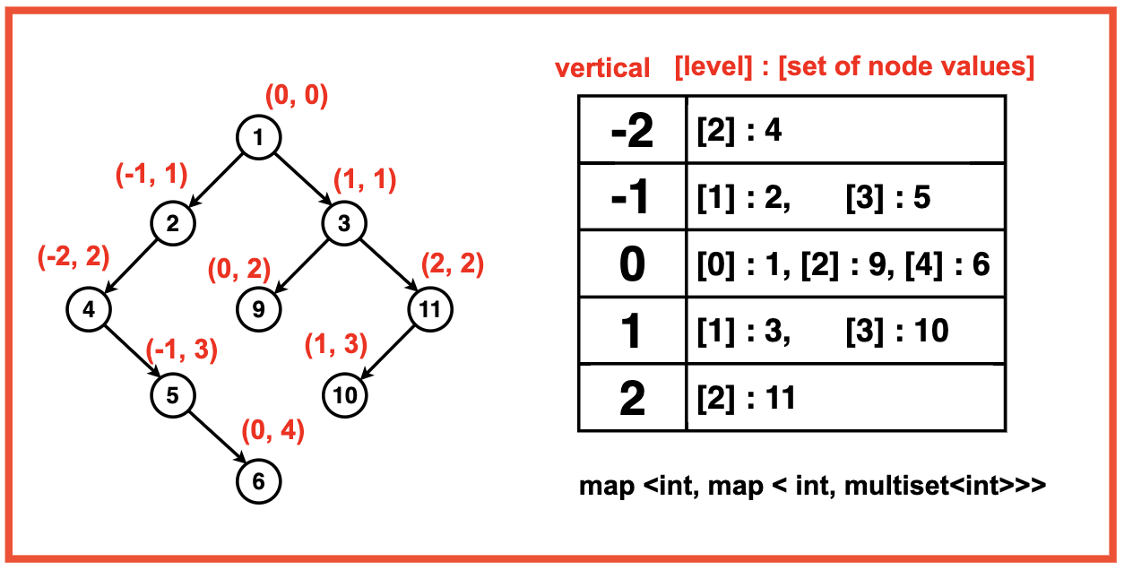
Vertical Order Traversal

Slide 40
public class VerticalOrderTraversal {
static class Qnode {
Node node;
int v, l;
Qnode(Node node, int v, int l) {
this.node = node;
this.v = v;
this.l = l;
}
}
static class Node {
int data;
Node left, right;
Node(int d) {
data = d;
left = right = null;
}
}
Node root = null;

Slide 41
Node create(Node root, int d) {
if (root == null) {
return new Node(d);
} else if (d <= root.data) {
root.left = create(root.left, d);
} else {
root.right = create(root.right, d);
}
return root;
}

Slide 42
public void verticalTraversal(Node root) {
TreeMap<Integer, TreeMap<Integer, LinkedList<Integer>>> map = new TreeMap<>();
Queue<Qnode> qdata = new LinkedList<>();
qdata.offer(new Qnode(root, 0, 0));
while (!qdata.isEmpty()) {
Qnode curr = qdata.poll();
int ver = curr.v;
int level = curr.l;

Slide 43
map.putIfAbsent(ver, new TreeMap<>());
map.get(ver).putIfAbsent(level, new LinkedList<>());
map.get(ver).get(level).add(curr.node.data);
if (curr.node.left != null) {
qdata.offer(new Qnode(curr.node.left, ver - 1, level + 1));
}
if (curr.node.right != null) {
qdata.offer(new Qnode(curr.node.right, ver + 1, level + 1));
}
}

Slide 44
for (TreeMap<Integer, LinkedList<Integer>> levels : map.values()) {
for (LinkedList<Integer> nodes : levels.values()) {
for (int num : nodes) {
System.out.print(num + " ");
}
}
}
}

Slide 45
public static void main(String[] args) {
Scanner scanner = new Scanner(System.in);
VerticalOrderTraversal tree = new VerticalOrderTraversal();
System.out.println("Enter number of nodes:");
int n = scanner.nextInt();
System.out.println("Enter node values:");
for (int i = 0; i < n; i++) {
int value = scanner.nextInt();
tree.root = tree.create(tree.root, value);
}
System.out.println("Vertical Order Traversal:");
tree.verticalTraversal(tree.root);
}
}

Slide 46
Graphs
Definition: A graph consists of vertices (nodes) and edges (connections between nodes).
Graph Representation: Graphs can be represented using various data structures such as adjacency matrix, adjacency list.
Graph Traversal: Depth-First Search (DFS) and Breadth-First Search (BFS). These are used to visit all nodes in the graph.
Graph Algorithms: various graph algorithms such as finding shortest paths (Dijkstra's algorithm, Bellman-Ford), minimum spanning tree (Prim's and Kruskal's algorithms), and more complex operations.

Slide 47
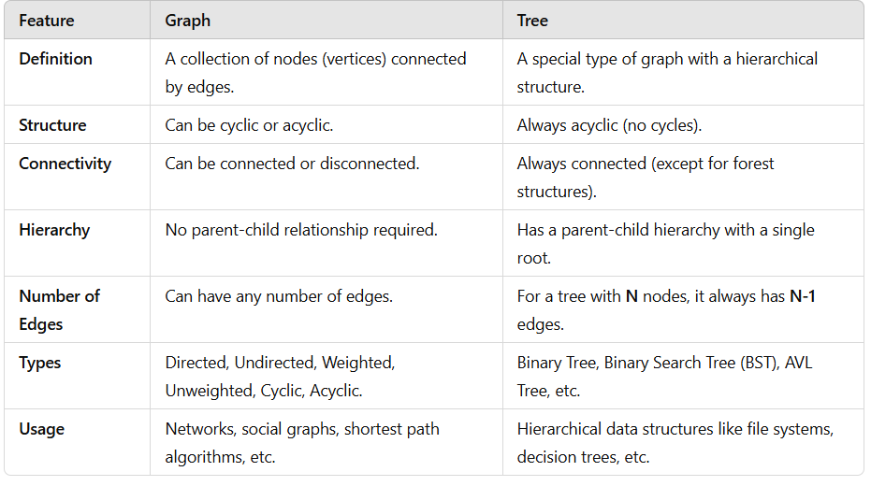

Slide 48
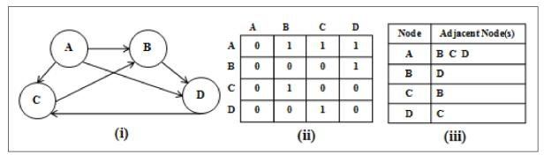
Adjacency Matrix and Adjacency List

Slide 49
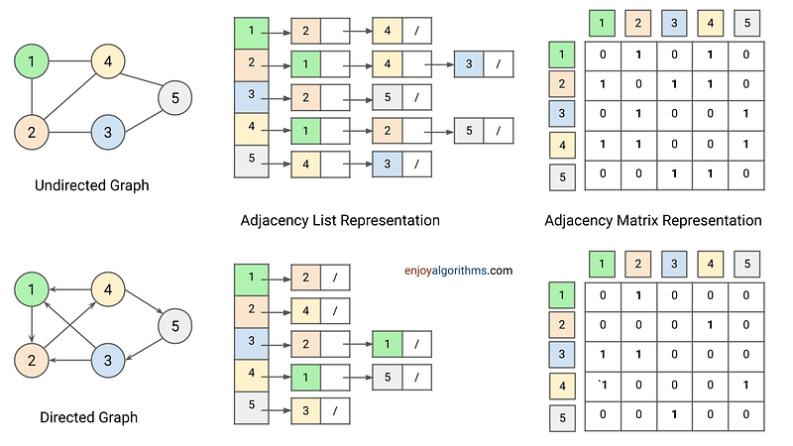

Slide 51
Graph Implementation using Adjacency Matrix
public class Graph_adjacency_Matrix {
private int v;
private int e;
private int adjmat[][];
public Graph_adjacency_Matrix(int nodes)
{
v=nodes;
e=0;
adjmat=new int[nodes][nodes];
}

Slide 52
public void addedge(int x,int y)
{
adjmat[x][y]=1;
adjmat[y][x]=1;
e++;
}
public void printAdjacencyMatrix() {
System.out.println("Adjacency Matrix:");
for (int i = 0; i < v; i++) {
for (int j = 0; j < v; j++) {
System.out.print(adjmat[i][j] + " ");
}
System.out.println();
}
}

Slide 53
public static void main(String[] args)
{
Graph_adjacency_Matrix graph=new Graph_adjacency_Matrix(4);
graph.addedge(0, 1);
graph.addedge(1, 2);
graph.addedge(2, 3);
graph.addedge(3, 0);
System.out.println("graph constists of "+graph.v+" vertices and "+graph.e+" edges");
graph.printAdjacencyMatrix();
}
}

Slide 54
Graph Implementation using Adjacency List
public class Graph_Ajancency_List {
private int v;
private int e;
private LinkedList<Integer>[] adj;
public Graph_Ajancency_List(int n)
{
v=n;
e=0;
adj=new LinkedList[n];
for(int i=0;i<n;i++)
{
adj[i]=new LinkedList<>();
}
}

Slide 55
public void addedge(int x,int y)
{
adj[x].add(y);
adj[y].add(x);
e++;
}
public void printAdjacencyList() {
System.out.println("Adjacency List:");
for (int i = 0; i < v; i++) {
System.out.print(i + " -> ");
for (int j : adj[i]) {
System.out.print(j + " ");
}
System.out.println();
}
}

Slide 56
public static void main(String[] args) {
Graph_Ajancency_List g=new Graph_Ajancency_List(4);
g.addedge(0,1);
g.addedge(1,2);
g.addedge(2,3);
g.addedge(3,0);
System.out.print("graph constists of "+g.v+" vertices and "+g.e+" edges");
g.printAdjacencyList();
}
}

Slide 58
Breadth First Search
Write a program to implement the BFS traversal of a graph.
Start the vertex from 0. To stop reading, read the edge as -1 -1. Start the BFS traversal from vertex 0.
If the number of vertices is 0 then print "Graph doesn't exist".
Input Format
first line contains number of nodes
second and further lines contains the edges (Stop reading when -1 -1 edge is encountered)

Slide 59
Code
public class BFS {
private int v;
private int e;
private LinkedList<Integer>[] adj;
public BFS(int n) {
v = n;
e = 0;
adj = new LinkedList[n];
for (int i = 0; i < n; i++) {
adj[i] = new LinkedList<>();
}
}

Slide 60
public void addedge(int x, int y) {
adj[x].add(y);
adj[y].add(x);
e++;
}
public void printAdjacencyList() {
System.out.println("\nAdjacency List:");
for (int i = 0; i < v; i++) {
System.out.print(i + " -> ");
for (int j : adj[i]) {
System.out.print(j + " ");
}
System.out.println();
}
}

Slide 61
public void bfsOfGraph() {
List<Integer> bfs = new ArrayList<>();
boolean[] vis = new boolean[v];
Queue<Integer> q = new LinkedList<>();
q.add(0);
vis[0] = true;
while (!q.isEmpty()) {
int node = q.poll();
bfs.add(node);
for (int neighbor : adj[node]) {
if (!vis[neighbor]) {
q.add(neighbor);
vis[neighbor] = true;
}
}
}

Slide 62
System.out.print("BFS : ");
for (int i : bfs) {
System.out.print(i + " ");
}
System.out.println();
}

Slide 63
public static void main(String[] args) {
Scanner sc = new Scanner(System.in);
int vertices = sc.nextInt();
if (vertices == 0) {
System.out.println("Graph doesn't exist");
return;
}
BFS graph = new BFS(vertices);
while (true) {
int u = sc.nextInt();
int v = sc.nextInt();
if (u == -1 && v == -1) break;
graph.addedge(u, v);
}
graph.bfsOfGraph();
}}

Slide 65
DFS(Depth First Search)
Input Format
Input consists of two integers n m ( number of nodes and number of edges)
m lines following
u v ( denotes an edge from u to v)

Slide 66
Sample Input 0
8 10
0 1
0 2
0 3
0 4
1 5
2 5
3 6
4 6
5 7
6 7
Sample Output 0
0 1 5 2 7 6 3 4
Sample Input 1
9 10 0 1 0 2 0 3 1 4 1 5 1 6 2 7 2 8 3 7 3 8
Sample Output 1
0 1 4 5 6 2 7 3 8

Slide 67
public class DFS {
static int v;
static LinkedList<Integer>[] adj;
DFS(int n) {
v = n;
adj = new LinkedList[n];
for (int i = 0; i < n; i++) {
adj[i] = new LinkedList<>();
}
}

Slide 68
public void addEdge(int x, int y) {
adj[x].add(y);
adj[y].add(x);
}
public void dfsTraversal(int startNode) {
boolean[] visited = new boolean[v];
List<Integer> dfsResult = new ArrayList<>();
dfsHelper(startNode, visited, dfsResult);
for (int node : dfsResult) {
System.out.print(node + " ");
}
System.out.println();
}

Slide 69
void dfsHelper(int node, boolean[] visited, List<Integer> res) {
visited[node] = true;
res.add(node);
for (int neighbor : adj[node]) {
if (!visited[neighbor]) {
dfsHelper(neighbor, visited, res);
}
}
}

Slide 70
public static void main(String[] args) {
Scanner sc = new Scanner(System.in);
int nodes = sc.nextInt();
int edges = sc.nextInt();
DFS graph = new DFS(nodes);
for (int i = 0; i < edges; i++) {
int u = sc.nextInt();
int v = sc.nextInt();
graph.addEdge(u, v);
}
graph.dfsTraversal(0);
}
}

Slide 71
Topological Sorting
Topological sorting for Directed Acyclic Graph (DAG) is a linear ordering of vertices such that for every directed edge u-v, vertex u comes before v in the ordering.
Note: Topological Sorting for a graph is not possible if the graph is not a DAG.

Slide 72
Why Topological Sort is not possible for graphs with undirected edges?

Slide 73
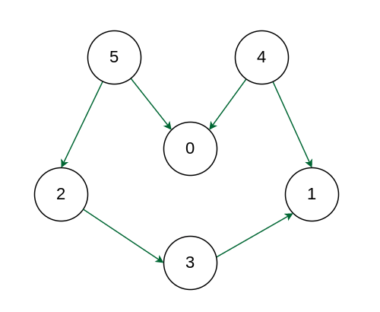
Example
Notes:
5 2 3 4 1 0

Slide 74
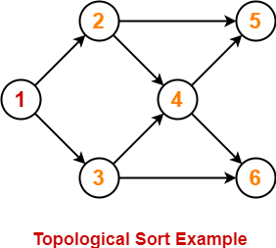
Example-2
Notes:
1 2 3 4 5 6

Slide 75
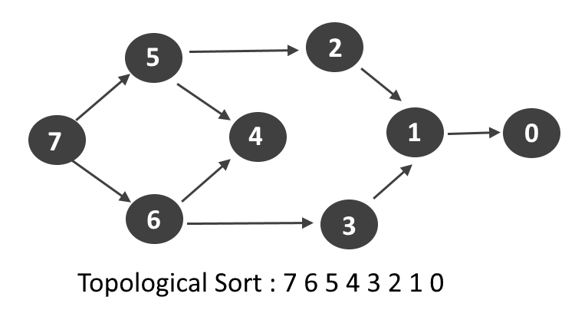
Example-3
Notes:
7 6 5 4 3 2 1 0

Slide 76
public class TopologicalSort {
public int v;
public LinkedList<Integer>[] adj;
public TopologicalSort(int n) {
v = n;
adj = new LinkedList[n];
for (int i = 0; i < n; i++) {
adj[i] = new LinkedList<>();
}
}

Slide 77
public void addEdge(int u, int v) {
adj[u].add(v);
}
public void dfs(int node, boolean[] visited, Stack<Integer> st) {
visited[node] = true;
for (int neighbor : adj[node]) {
if (!visited[neighbor]) {
dfs(neighbor, visited, st);
}
}
st.push(node);
}

Slide 78
public void topologicalSort() {
Stack<Integer> st = new Stack<>();
boolean[] visited = new boolean[v];
for (int i = 0; i < v; i++) {
if (!visited[i]) {
dfs(i, visited, st);
}
}
while (!st.isEmpty()) {
System.out.print(st.pop() + " ");
}
System.out.println();
}

Slide 79
public static void main(String[] args) {
Scanner sc = new Scanner(System.in);
int nodes = sc.nextInt();
int edges = sc.nextInt();
TopologicalSort graph = new TopologicalSort(nodes);
for (int i = 0; i < edges; i++) {
int u = sc.nextInt();
int v = sc.nextInt();
graph.addEdge(u, v);
}
System.out.println("Topological Sorting: ");
graph.topologicalSort();
}
}

Slide 80
Dijkstra’s Algorithm
Dijkstra's algorithm finds the shortest path from one vertex to all other vertices.
It works for both directed and undirected graphs.
Uses greedy approach
Always source node distance will be zero.

Slide 81
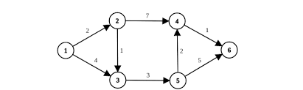
Example-01
Notes:
0 2 3 8 6 9

Slide 82
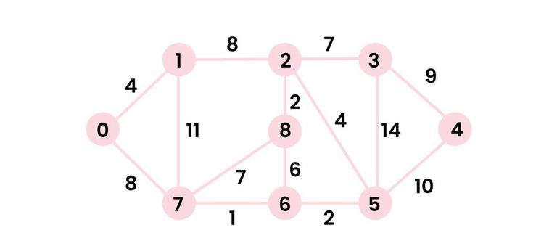
Example-2
Notes:
0 4 12 19 28 16 18 8 14

Slide 83
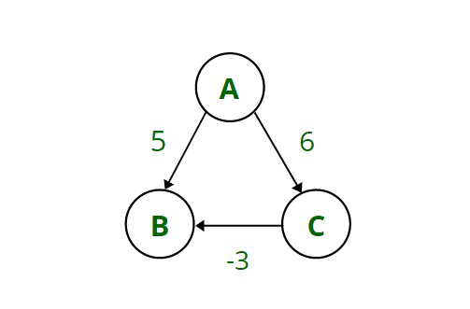
Disadvantages of Dijkstra’s Algorithm:
It is unable to handle negative weights.

Slide 84
Bellman Ford Algorithm
Bellman-Ford is a fundamental algorithm in graph theory used to find the shortest paths from a single source vertex to all other vertices in a weighted graph.
Single Source Shortest Path: Bellman-Ford computes shortest paths from a source vertex to all other vertices in a graph with negative edge weights, unlike Dijkstra's algorithm which requires non-negative weights.

Slide 85
How Bellman-Ford Works
Step 1: Initialize distances (Set source distance = 0, all others = infinity)
Step 2: Relax all edges (V-1) times
Step 3: Check for negative weight cycles

Slide 86
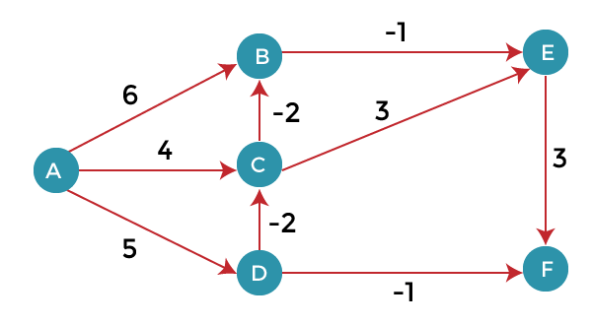
Example-01
Notes:
0 1 3 5 0 3

Slide 87
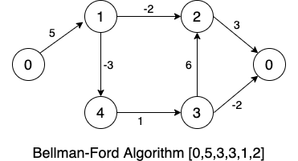
Example-02
Notes:
0 5 3 3 2 1

Slide 88
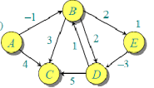

Example-3

Slide 89
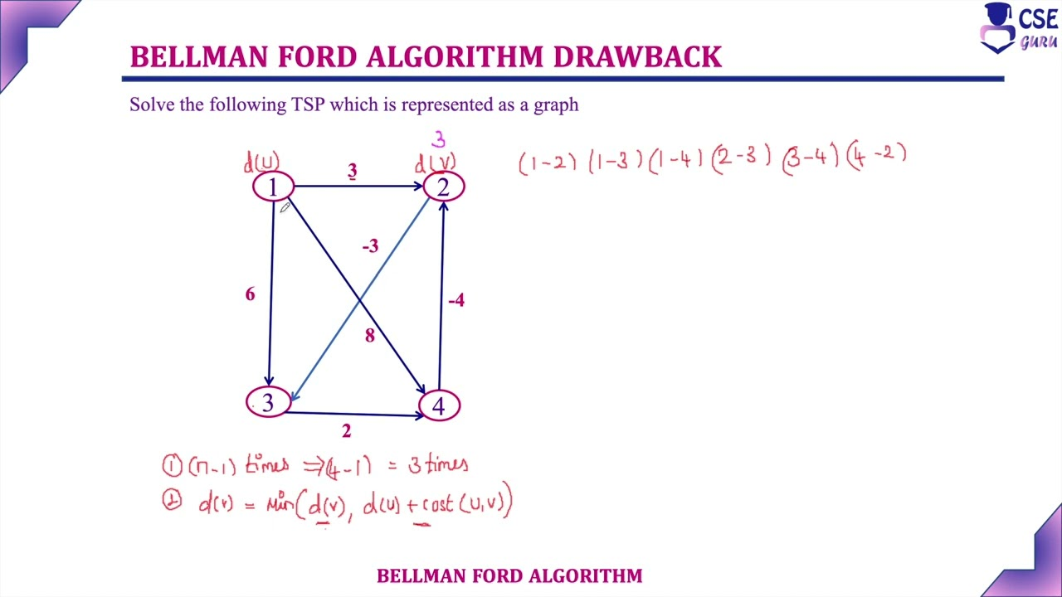
Drawback

Slide 90
While Bellman-Ford can detect negative weight cycles, this is also a disadvantage as it means the algorithm will not find a true shortest path if such a cycle exists in the graph.
If the graph has no negative edge weights, using Bellman-Ford is less efficient compared to Dijkstra's algorithm which is specifically designed for such scenarios

Slide 91
Code
class Bellmans_Algorithm {
static class Edge {
int src, dest, weight;
Edge(int src, int dest, int weight) {
this.src = src;
this.dest = dest;
this.weight = weight;
}
}

Slide 92
public static void bellmanFord(int n, int m, List<Edge> edges, int src) {
int[] dist = new int[n];
Arrays.fill(dist, Integer.MAX_VALUE);
dist[src] = 0;
for (int i = 0; i < n - 1; i++) {
for (Edge edge : edges) {
if (dist[edge.src] != Integer.MAX_VALUE && dist[edge.src] + edge.weight < dist[edge.dest]) {
dist[edge.dest] = dist[edge.src] + edge.weight;
}
}
}

Slide 93
for (Edge edge : edges) {
if (dist[edge.src] != Integer.MAX_VALUE && dist[edge.src] + edge.weight < dist[edge.dest]) {
System.out.println("-1"); // Negative cycle detected
return;
}
}
for (int i = 0; i < n; i++) {
System.out.print((dist[i] == Integer.MAX_VALUE ? "-1" : dist[i]) + " ");
}
System.out.println();
}

Slide 94
public static void main(String[] args) {
Scanner sc = new Scanner(System.in);
int n = sc.nextInt();
int m = sc.nextInt();
List<Edge> edges = new ArrayList<>();
for (int i = 0; i < m; i++) {
int u = sc.nextInt();
int v = sc.nextInt();
int w = sc.nextInt();
edges.add(new Edge(u, v, w));
}
bellmanFord(n, m, edges, 0);
}
}

Slide 95
Dial’s Algorithm
Dijkstra’s shortest path algorithm runs in O(Elog V) time when implemented with adjacency list representation.
Can we optimize Dijkstra’s shortest path algorithm to work better than O(E log V) if the maximum weight is small (or the range of edge weights is small)?

Slide 96
Dijkstra’s algorithm can be modified by using different data structures, and buckets, which is called dial implementation of Dijkstra’s algorithm. time complexity is O(E + WV) where W is the maximum weight on any edge of the graph, so we can see that, if W is small then this implementation runs much faster than the traditional algorithm.

Slide 97
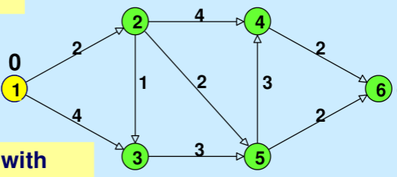
Example-01
Result????
Notes:
0 2 3 6 4 6

Slide 98
Algorithm
Maintains some buckets, numbered 0, 1, 2,…,wV.
Bucket k contains all temporarily labeled nodes with a distance equal to k.
Nodes in each bucket are represented by a list of vertices.
Buckets 0, 1, 2,..wV are checked sequentially until the first non-empty bucket is found. Each node contained in the first non-empty bucket has the minimum distance label by definition.
One by one, these nodes with minimum distance labels are permanently labeled and deleted from the bucket during the scanning process.

Slide 99
6. Thus operations involving vertex include:
Checking if a bucket is empty
Adding a vertex to a bucket
Deleting a vertex from a bucket.
7. The position of a temporarily labeled vertex in the buckets is updated accordingly when the distance label of a vertex changes.
8. The process is repeated until all vertices are permanently labeled (or the distances of all vertices are finalized).

Slide 100
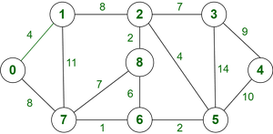
Example-02
Notes:
0 4 12 19 21 11 9 8 14

Slide 101
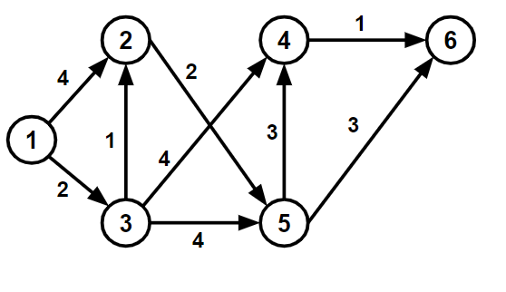
Example-03
Notes:
0 3 2 6 5 7

Slide 102
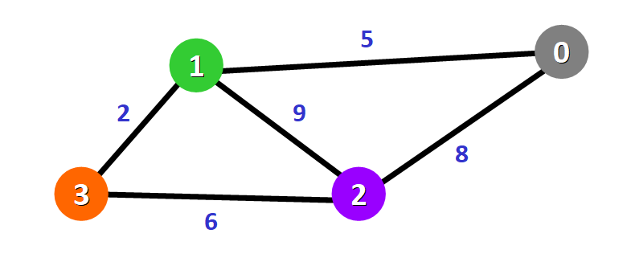
Example-04
Notes:
0 5 8 7

Slide 103
Dial’s Algorithm Code
class Dials_Algorithm{
static class Node {
int vertex, weight;
Node(int v, int w) {
this.vertex = v;
this.weight = w;
}
}

Slide 104
public static int[] dialsAlgorithm(List<List<Node>> graph, int src, int maxWeight) {
int V = graph.size();
int[] dist = new int[V];
Arrays.fill(dist, Integer.MAX_VALUE);
dist[src] = 0;
List<Queue<Integer>> buckets = new ArrayList<>();
for (int i = 0; i <= maxWeight * V; i++) {
buckets.add(new LinkedList<>());
}
buckets.get(0).add(src);
int index = 0;
while (index < buckets.size()) {
while (!buckets.get(index).isEmpty()) {
int u = buckets.get(index).poll();
for (Node neighbor : graph.get(u)) {
int v = neighbor.vertex;
int weight = neighbor.weight;
int newDist = dist[u] + weight;
if (newDist < dist[v]) {
dist[v] = newDist;
buckets.get(newDist).add(v);
}}}
while (index < buckets.size() && buckets.get(index).isEmpty()) {
index++;
}}
return dist;
}

Slide 105
public static void main(String[] args) {
Scanner sc = new Scanner(System.in);
System.out.println("Enter number of vertices:");
int V = sc.nextInt();
System.out.println("Enter number of edges:");
int E = sc.nextInt();
System.out.println("Enter the maximum edge weight:");
int maxWeight = sc.nextInt();
List<List<Node>> graph = new ArrayList<>();
for (int i = 0; i < V; i++) {
graph.add(new ArrayList<>());
}
System.out.println("Enter edges in the format: source destination weight");
for (int i = 0; i < E; i++) {
int u = sc.nextInt(); int v = scanner.nextInt();
int w = scanner.nextInt();
graph.get(u).add(new Node(v, w));
graph.get(v).add(new Node(u, w));
}

Slide 106
System.out.println("Enter the source vertex:");
int source = scanner.nextInt();
int[] distances = dialsAlgorithm(graph, source, maxWeight);
System.out.println("Shortest distances from node " + source + ":");
for (int i = 0; i < distances.length; i++) {
System.out.println("To " + i + " -> " + (distances[i] == Integer.MAX_VALUE ? "INF" : distances[i]));
}
}
}

Slide 107
Heap
.

Slide 108
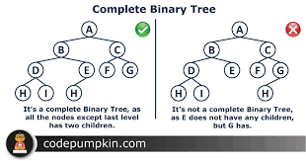

Slide 109
Intro…
A Heap is a special Tree-based Data Structure that has the following properties.
It is a Complete Binary Tree.
It either follows max heap or min heap property.
Max-Heap: The value of the root node must be the greatest among all its descendant nodes and the same thing must be done for its left and right sub-tree also.

Slide 110
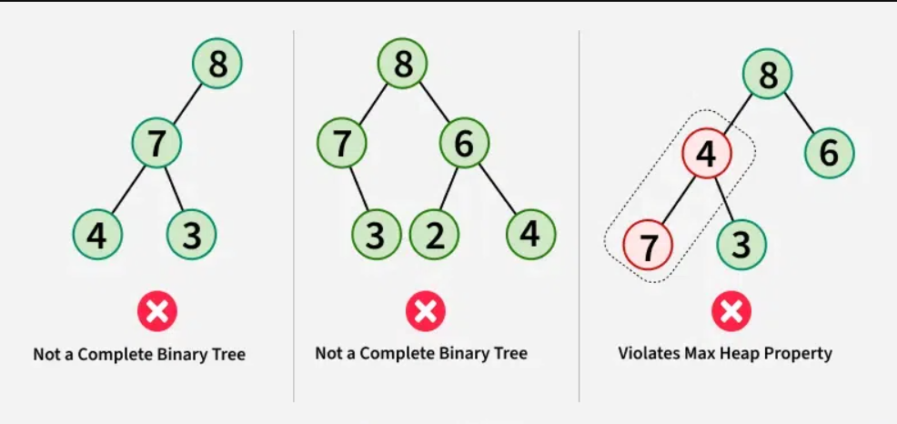
Max Heap??????

Slide 112
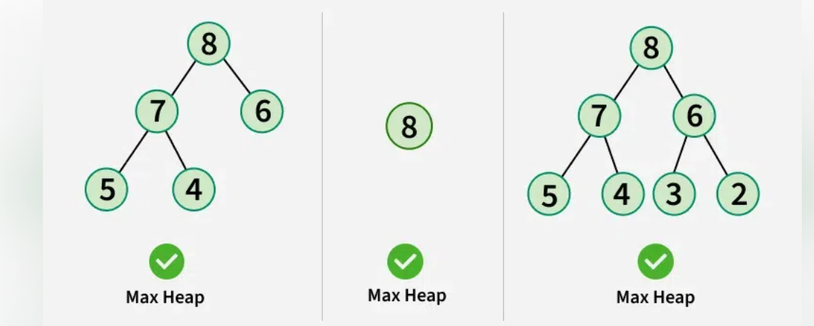

Slide 113
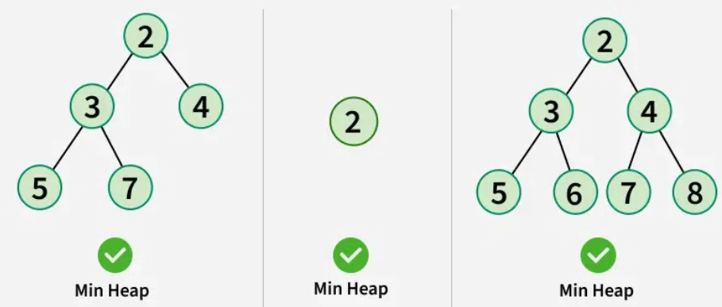
Min-Heap: The value of the root node must be the smallest among all its descendant nodes and the same thing must be done for its left and right sub-tree also.

Slide 114
Properties of Heap:
The minimum or maximum element is always at the root of the heap, allowing constant-time access.
The relationship between a parent node at index ‘i’ and its children is given by the formulas: left child at index 2i+1 and right child at index 2i+2 for 0-based indexing of node numbers.
As the tree is complete binary, all levels are filled except possibly the last level. And the last level is filled from left to right.
When we insert an item, we insert it at the last available slot and then rearrange the nodes so that the heap property is maintained.
When we remove an item, we swap root with the last node to make sure either the max or min item is removed. Then we rearrange the remaining nodes to ensure heap property (max or min)

Slide 115
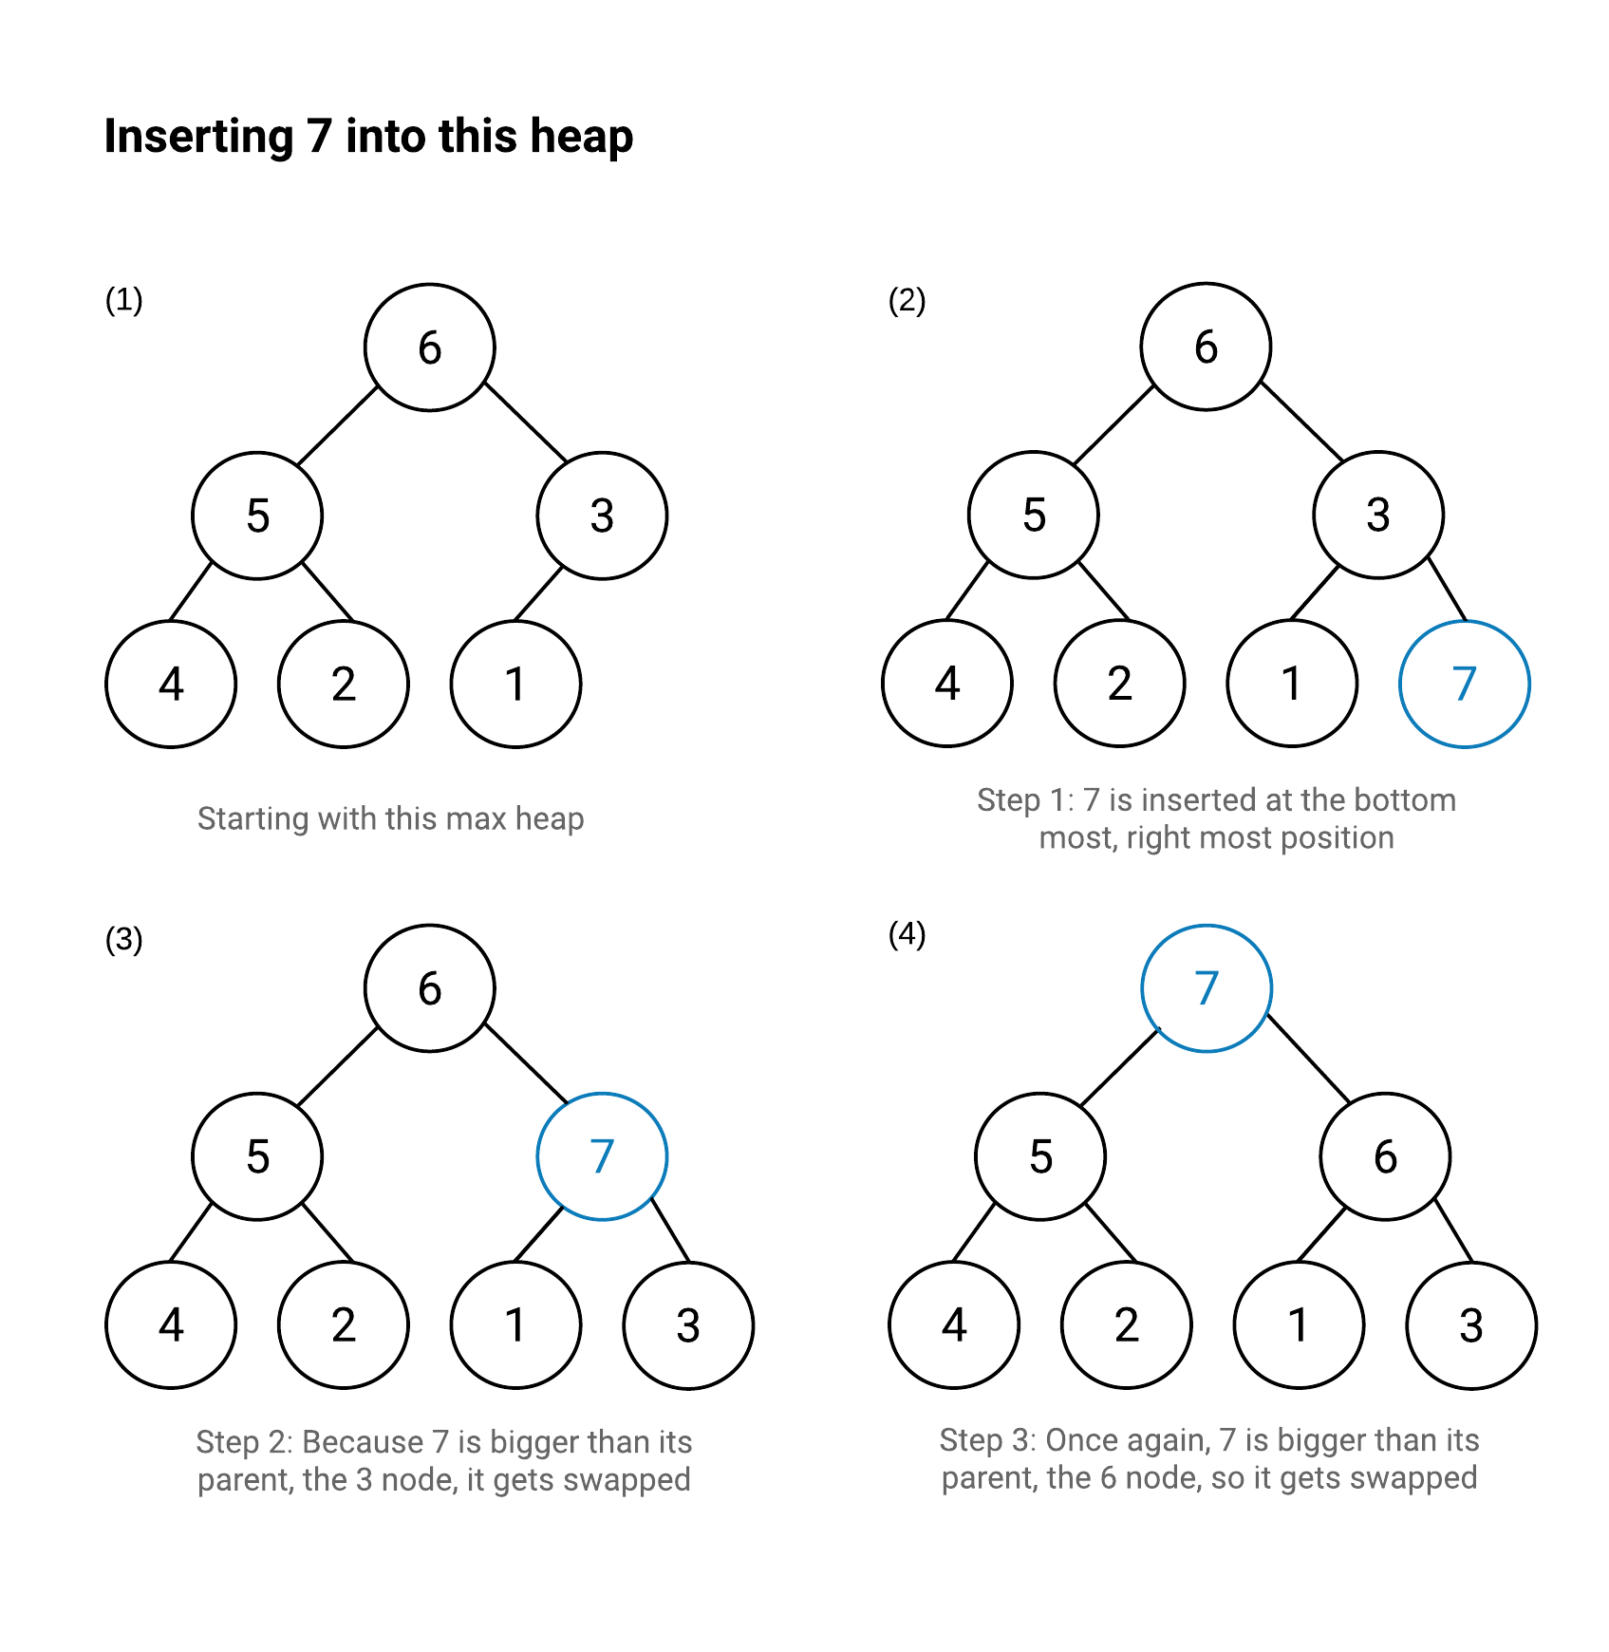

Slide 116
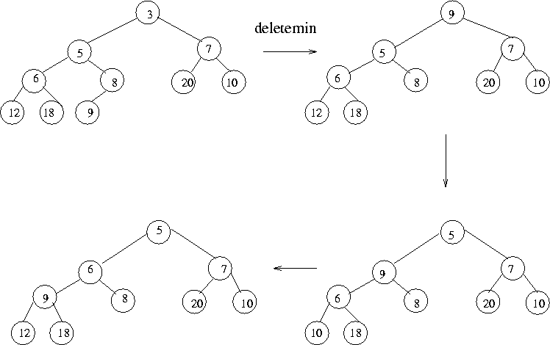

Slide 117
Max Heap Implementation
class MaxHeap {
int[] heap;
int size;
int capacity;
public MaxHeap(int capacity) {
this.capacity = capacity;
this.size = 0;
heap = new int[capacity];
}

Slide 118
int parent(int index) {
return (index - 1) / 2;
}
int leftChild(int index) {
return 2 * index + 1;
}
int rightChild(int index) {
return 2 * index + 2;
}
void swap(int i, int j) {
int temp = heap[i];
heap[i] = heap[j];
heap[j] = temp;
}

Slide 119
public void insert(int value) {
if (size == capacity) {
System.out.println("Heap is full");
return;
}
heap[size] = value;
int current = size;
size++;
while (current > 0 && heap[current] > heap[parent(current)]) {
swap(current, parent(current));
current = parent(current);
}
}

Slide 120
public int extractMax() {
if (size == 0) {
throw new IllegalStateException("Heap is empty");
}
int max = heap[0];
heap[0] = heap[size - 1];
size--;
heapify(0);
return max;
}
public void printHeap() {
System.out.println(Arrays.toString(Arrays.copyOfRange(heap, 0, size)));
}

Slide 121
void heapify(int index) {
int largest = index;
int left = leftChild(index);
int right = rightChild(index);
if (left < size && heap[left] > heap[largest]) {
largest = left;
}
if (right < size && heap[right] > heap[largest]) {
largest = right;
}
if (largest != index) {
swap(index, largest);
heapify(largest);
}
}

Slide 122
public static void main(String[] args) {
MaxHeap maxHeap = new MaxHeap(10);
maxHeap.insert(15);
maxHeap.insert(10);
maxHeap.insert(30);
maxHeap.insert(40);
maxHeap.insert(50);
maxHeap.printHeap();
System.out.println("Extracted Max: " + maxHeap.extractMax());
maxHeap.printHeap();
}
}

Slide 123
Heap Sort
int a[]=new int[maxHeap.size];
maxHeap.printHeap();
for(int i=maxHeap.size-1;i>=0;i--) a[i]=maxHeap.extractMax();
for(int i:a) System.out.print(i+" ");

Slide 124
Heap Sort
Write a program to perform heap sort on the given array
Sample Input 0
5 12 11 13 5 6
Sample Output 0
5 6 11 12 13
Sample Input 1
6 2 3 4 57 8 9
Sample Output 1
2 3 4 8 9 57

Slide 125
Code
public class HeapSort {
public static void main(String[] args) {
Scanner sc = new Scanner(System.in);
int n = sc.nextInt();
int arr[] = new int[n];
for (int i = 0; i < n; i++) {
arr[i] = sc.nextInt();
}
heapSort(arr);
printArray(arr);
}

Slide 126
public static void heapSort(int arr[]) {
int n = arr.length;
for (int i = n / 2 - 1; i >= 0; i--)
heapify(arr, n, i);
for (int i = n - 1; i > 0; i--) {
int temp = arr[0];
arr[0] = arr[i];
arr[i] = temp;
heapify(arr, i, 0);
}
}

Slide 127
static void heapify(int arr[], int n, int i) {
int largest = i;
int left = 2 * i + 1;
int right = 2 * i + 2;
if (left < n && arr[left] > arr[largest])
largest = left;
if (right < n && arr[right] > arr[largest])
largest = right;
if (largest != i) {
int swap = arr[i];
arr[i] = arr[largest];
arr[largest] = swap;
heapify(arr, n, largest);
}
}
}

Slide 128
K-Ary Heap
A k-ary heap is a complete tree (all levels except possibly the last are fully filled) where:
Each node has at most k children.
It satisfies the heap property:
Min-heap: The key at each parent node is less than or equal to the keys of its children.
Max-heap: The key at each parent node is greater than or equal to the keys of its children.

Slide 129
Properties
Parent and Child Indexing (for a 0-based array representation):
1.Parent of node at index i:
parent(i)=(i−1)/k
2. Children of node at index i:
child(i,j)=(k *i)+1,(k*i)+2,……..(k*i)+j
where j=1 to k
3. Height:The height of a k-ary heap with n elements is: O(log⁡n)
Note : log(n)base k.

Slide 130
Example
Implement Max k-ary heap from the given list [10 9 6 7 8 4 5 ] and no of child’s(k=3).
3-ary heap
10
/ | \
9 6 7
/ | \
8 4 5

Slide 131
Example
[10 23 56 78 90 45 67 78 55 12]
K=4
4-ary heap [10 23 56 78 90 45 67 78 55 12]

Slide 132
Code(Max K-ary heap)
public class Main{
static int k;
static ArrayList<Integer> al=new ArrayList<>();
static int parent(int i) {
return (i-1)/k;
}
static void swap(int pi,int i) {
int temp=al.get(pi);
al.set(pi,al.get(i));
al.set(i,temp);}

Slide 133
Code
static void insert(int d) {
al.add(d);
int i=al.size()-1;
while(i>0 && al.get(parent(i))<al.get(i)){
swap(parent(i),i);
i=parent(i);
} }

Slide 134
Code
public static void main(String[] args)
{
Scanner sc=new Scanner(System.in);
int n=sc.nextInt();
k=sc.nextInt();
for(int i=0;i<n;i++)
{
insert(sc.nextInt());
}
System.out.print(al);
}

Slide 135
ExtractMax()
static int ExtractMax(ArrayList<Integer> al) {
int max=al.get(0);
al.set(0,al.get(al.size()-1));
al.remove(al.size()-1);
heapify(0);
return max;
}
static int child(int i,int j) { return (k*i)+j; }

Slide 136
Code
static void heapify(int i) {
int large=i;
for(int j=1;j<=k;j++) {
int childIndex=child(i,j);
if(childIndex<al.size() && al.get(large)<al.get(childIndex)) { large=childIndex;
}}
if(large!=i) {
swap(large,i);
heapify(large); } }

Slide 137
Binomial Heap
In data structures , a binomial heap is a heap which is similar to a binary heap but also supports quick merging of two heaps.
A binomial heap is a specific implementation of the heap data structure.
Binomial heaps are collections of binomial trees that are linked together where each tree is an ordered heap.

Slide 138
Binomial Tree
Binomial Tree is an ordered tree
A binomial tree of order k can be constructed by taking two binomial trees of order (k-1) and making one tree as the leftmost child of the other tree.
Rules:
Bk has k children of root.
Bk be formed using Bk-1 trees.
The root of one Bk-1 will be the leftmost child of the other Bk-1 tree.

Slide 139
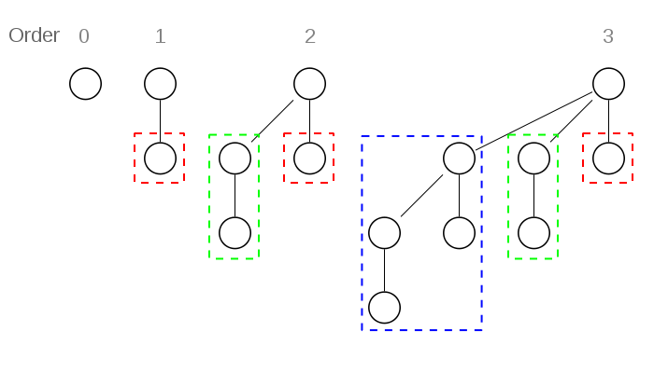
What will be the B4?

Slide 140
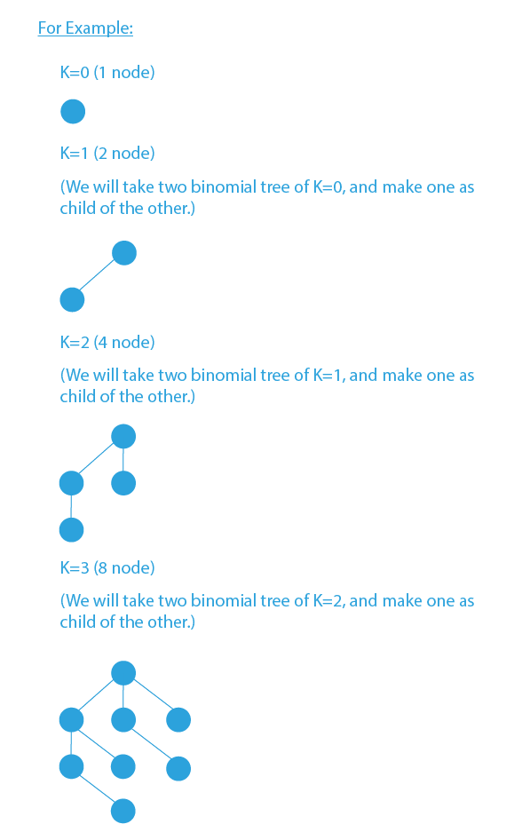

Slide 141
Properties of Binomial Trees
An order k binomial tree B_{k}​ has the following properties:
The height of the tree is k
There are a total of 2^{k} nodes in the tree.
The degree of the root is k.
The maximum degree of any node in a binomial tree is log n.
There are exactly ^{k}C_{i} nodes at depth i in a binomial tree B_{k}

Slide 142
Rules of Binomial Heap
A Binomial heap is implemented as a set of binomial trees that satisfy the binomial heap properties:
Each binomial tree should obey the min-heap property(the root node is lesser than its children).
There should not be more than one binomial tree with same order.
Binomial Heap should be arranged in ascending order.(Order of tree only should be arranged not elements)

Slide 143
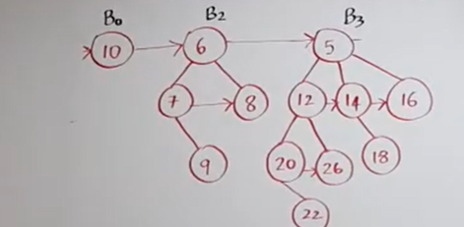
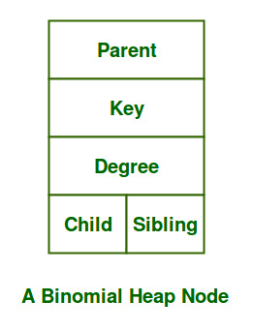
Structure of a Binomial Tree

Slide 144
Binomial Heap and the Binary Representation of a Number 15→1111→B3,B2,B1,B0 11→1011→B3,B1,B0

Slide 145
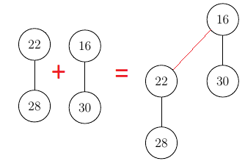
Merging of two binomial trees
The simplest operation is the merging of two binomial trees of same order within a binomial heap.
As their root node is the smallest element within the tree,by comparing the two keys , the smaller of them is the minimum key and becomes the new root node. Then the other tree becomes a subtree of the combined tree.

Slide 146
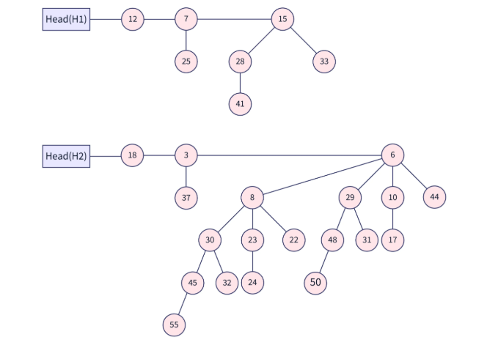
Example-02

Slide 147
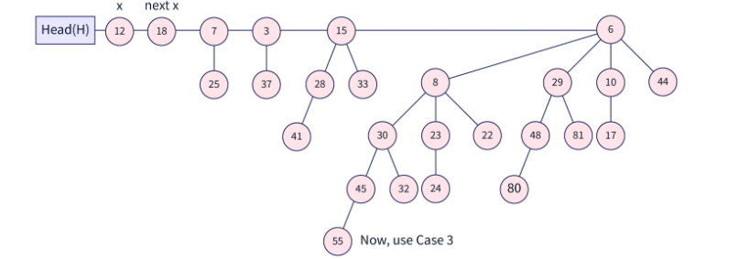

Slide 148
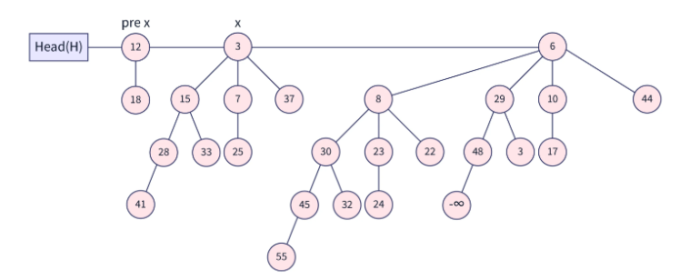
Final Output

Slide 149
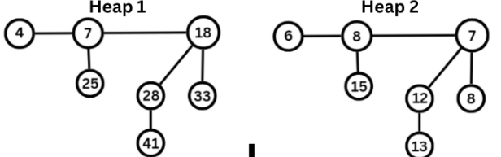
Practice

Slide 150
Operation in Binomial Heap
Operation | Time Complexity
Insert | O(log n)
Find Min | O(log n)
Union (Meld) | O(log n)
Extract Min | O(log n)
Decrease Key | O(log n)
Delete | O(log n)

Slide 151
Winner Tree
Winner Tree is a complete binary tree in which each node is representing the smaller or greater of its two children.
The root will hold smallest or greatest node of a tree.
There are two types of winner Trees:
Max Winner Tree
Min Winner Tree

Slide 152
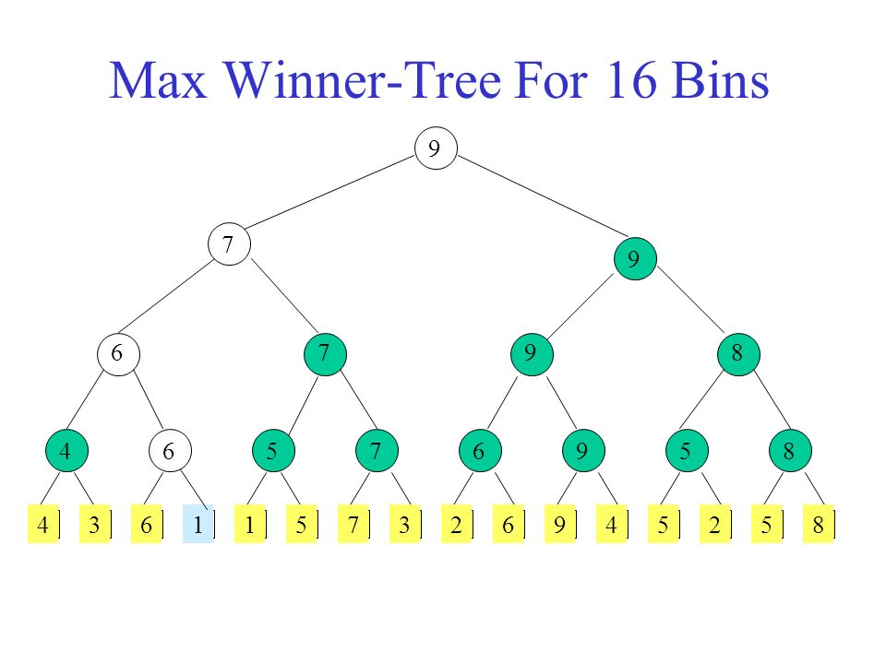
Max Winner Tree

Slide 153
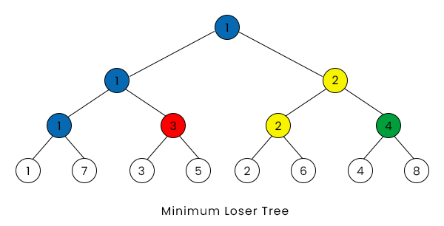
Min Winner Tree

Slide 154
Code(Min Winner Tree)
import java.util.*;
class Main{
public static void main(String args[]) {
Scanner sc=new Scanner(System.in);
int k=sc.nextInt();
int size=(2*k)-1;
int tree[]=new int[size];
for(int i=k-1;i<size;i++) {
tree[i]=sc.nextInt();
}

Slide 155
Code(Min Winner Tree)
for(int i=k-2;i>=0;i--) {
if(tree[(2*i)+1]<tree[(2*i)+2]) {
tree[i]=tree[(2*i)+1];
}
else{
tree[i]=tree[(2*i)+2];
}
}
System.out.println(tree[0]); }}

Slide 156
Max Sliding Window
You are given an array of integers nums, there is a sliding window of size k which is moving from the very left of the array to the very right. You can only see the k numbers in the window. Each time the sliding window moves right by one position.
Return the max sliding window.
Example 1:
Input: nums = [1,3,-1,-3,5,3,6,7], k = 3
Output: [3,3,5,5,6,7]

Slide 157
Explanation
Explanation:
Window position Max
--------------- -----
[1 3 -1] -3 5 3 6 7 3
1 [3 -1 -3] 5 3 6 7 3
1 3 [-1 -3 5] 3 6 7 5
1 3 -1 [-3 5 3] 6 7 5
1 3 -1 -3 [5 3 6] 7 6
1 3 -1 -3 5 [3 6 7] 7

Slide 158
Code
import java.util.Scanner;
class Main{
public static void main(String ar[]){
Scanner sw = new Scanner(System.in);
int n =sw.nextInt();
int a[]=new int[n];
for(int i=0;i<n;i++)
a[i]=sw.nextInt();
int k = sw.nextInt();

Slide 159
Code
for(int i=0;i<=n-k;i++){
int max = Integer.MIN_VALUE;
for(int j=i;j<k+i;j++){
if(max<a[j]) max = a[j];
}
System.out.print(max+" ");
} }}

